Slide 1

Exploratory Study: Heavy Metal Correlations
By: Vincent Preikstas

Slide 2
About Me
Graduated with a degree in computer science from SUNY Oswego
Studying HCI and HIT at SUNY Oswego
Interests: Algorithm Design and Interface Design

Slide 3
Introduction
Purpose of project is to investigate heavy metal levels in blood
Inspiration from blackboard suggested project “Effects of metals on cell biology, cardiovascular systems, and autism”
Turned into exploratory study after data preprocessing

Slide 4
Acquiring Data
Data was Acquired from Dr. Isabelle Bichindaritz in Syracuse
Part of ongoing research into Metabolomics

Slide 5
Data Preprocessing
Initial dataset had over 600 attributes, was reduced to 41 attributes
298 tuples present in dataset, some with missing fields
Data Dictionary for reduced data set available in project report

Slide 6
Analysis Tools Used and Algorithms
Main software used was SPSS by IBM
Algorithms used were binary logistic regression and linear regression

Slide 7
Overview of Analysis
Binary Logistic Regression applied to attributes gender, race, ibuprofen use, aspirin use, vitamin use
Linear Regression applied to lead, cadmium and mercury levels

Slide 8

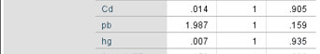
Results: Gender
No metal correlation. Correlated with lipoprotein, ibuprofen, alanine and threonine
Variables Considered Alone Variables Considered Together

Slide 9
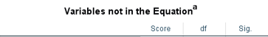
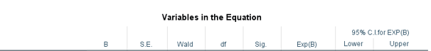
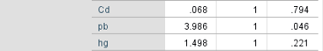
Results: Race
Correlation with lead and cadmium, many other correlations as well
Variables Considered Alone Variables Considered Together

Slide 10
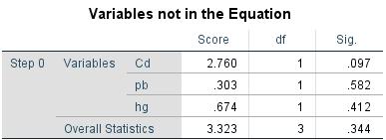
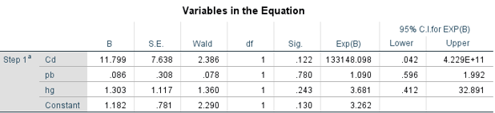
Results: Aspirin
No correlation with heavy metals
Variables Considered Alone Variables Considered Together

Slide 11
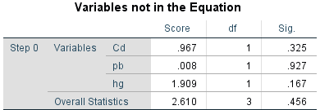
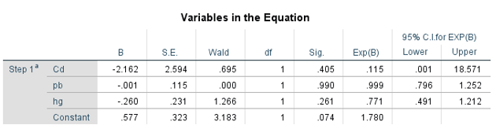
Results Ibuprofen
No correlation with heavy metals
Variables Considered Alone Variables Considered Together

Slide 12
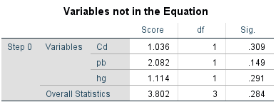
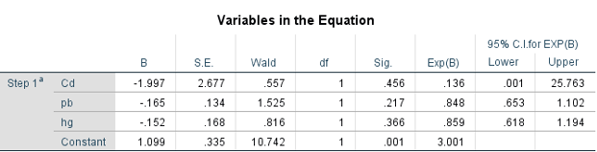
Results: Vitamins
No correlation with heavy metals
Variables Considered Alone Variables Considered Together

Slide 13
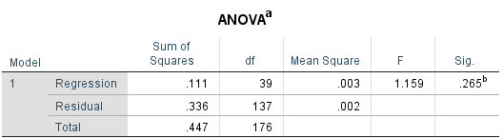
Results: Cadmium
Okay F value, but bad significance value for the model and no significant predictor attributes

Slide 14
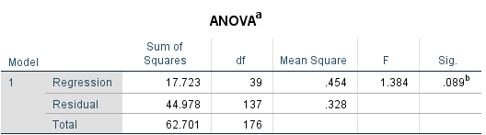
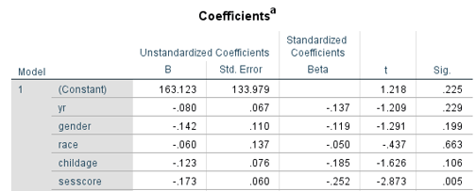
Results: Lead
Okay F value, bad significance value for model. Model does have significant predictor in socioeconomic score

Slide 15
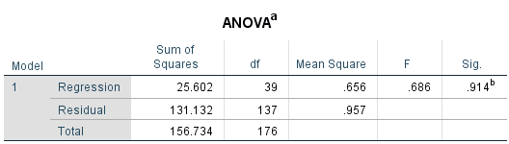
Results: Mercury
Very bad F value and Significance value for model. No significant attributes for prediction

Slide 16
Conclusion
Race correlated with lead levels when considering attributes alone and correlated with cadmium when considering attributes together
No interesting correlations with Ibuprofen, aspirin or vitamin use
Socioeconomic score being predictive of lead was interesting, but significance of model means cannot confidently rule out random chance

Slide 17
Thank you for your time
If you have any questions, please feel free to email me
Contact email: Vpreikst@Oswego.edu

